Slide 1
The Giver
Novel study

Slide 2
What is the message?
The message of the novel is not everything is as it seems, don’t judge by appearance. At first the novel gives us the impression that it is an Utopian society, a perfect world. Later on we come to terms with the fact that is a dystopia. Before you judge things dig a little further and don’t make assumptions.
The community functions well and everybody works together, everyone seems happy. As you progress throughout the book you find out that even though the community and all it’s rules and ways of doing things aren’t so perfect. For example, taking pills to supress your emotions, not seeing colour, not being able to be unique and express your thoughts, your life is mapped out for you and you don’t have any rights.

Slide 3
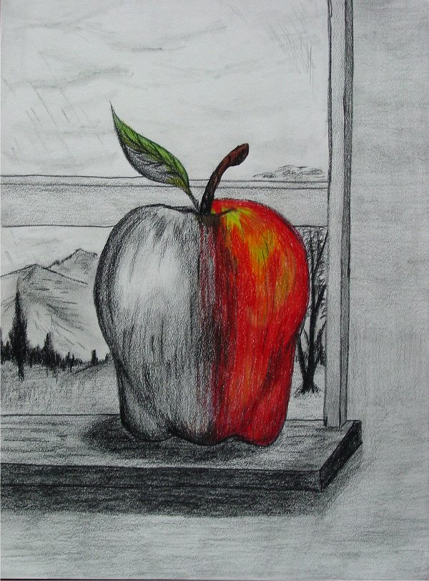
Lois Lowry wants us to think about these issues because they are what we experience everyday. What is life without, feelings, colour and choices? Individuality is what makes up the world, its okay to be different, unique. In life we have to experience sadness, happiness and danger. We need to make mistakes to learn from them.
There is no such thing as a perfect world because everyone’s interpretation of ‘perfect’ differs.

Slide 4
Setting of the Novel
I see the community as a bleak and quiet place. I see the people as robots because they are being controlled, their lives are monitored, they have no say. I see the community as a prison. I see it as a lifeless place, no trace of human habitation, the life is sucked out of everyone. Everyone is the same, no such thing as ‘unique.’
The streets have no character, all the same. No weeds, rubbish, cracked pathways. No gum under table and chairs. No squealing children begging for more ice cream. All of those things are what makes up a street, a community.

Slide 5
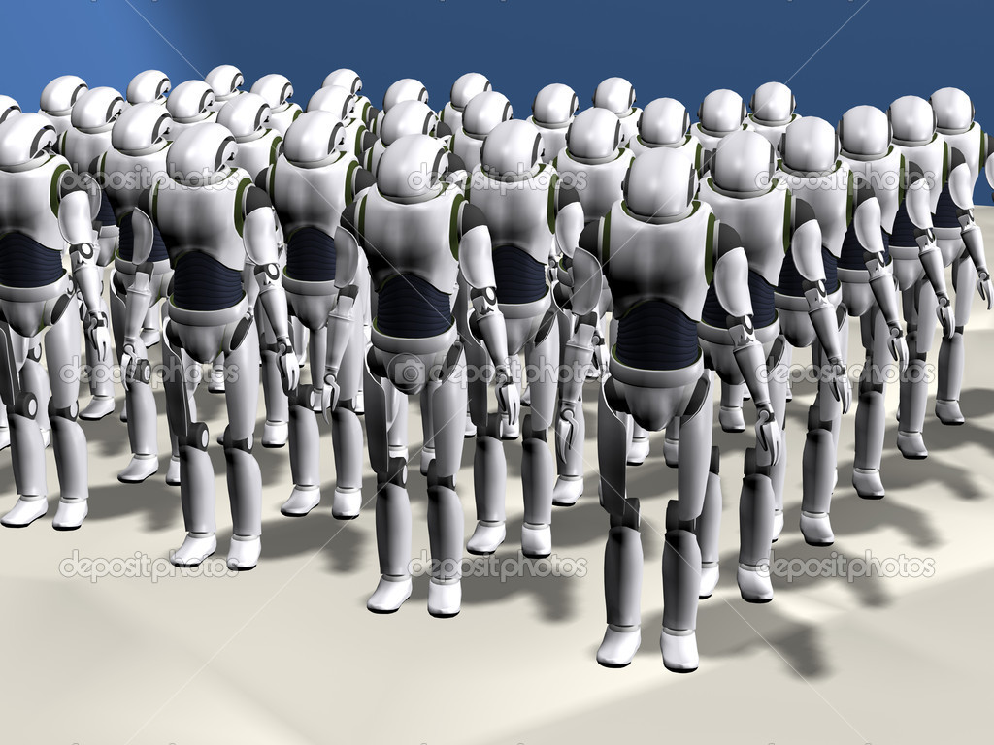
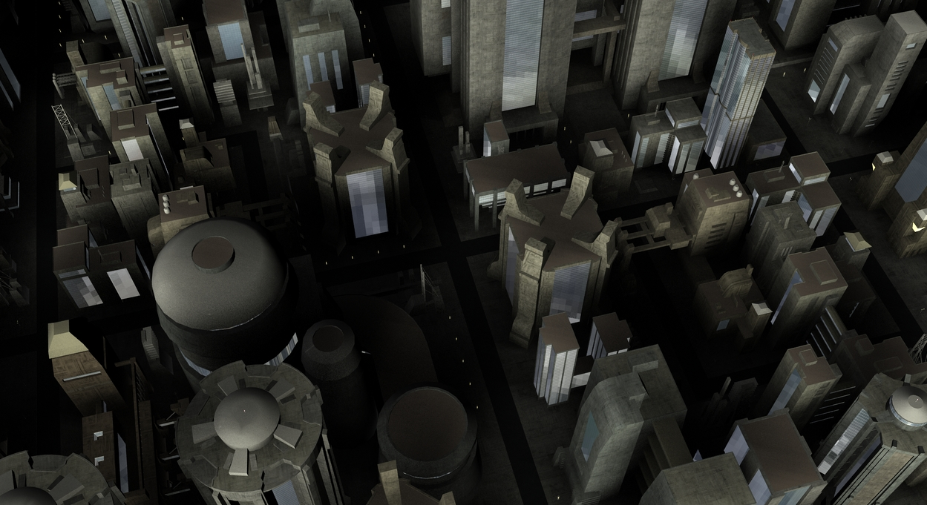
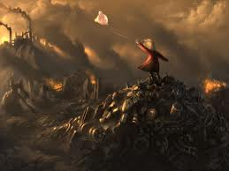
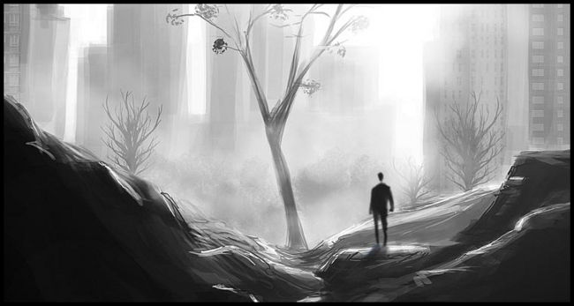
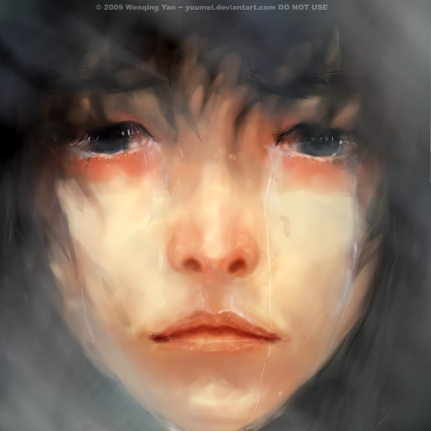
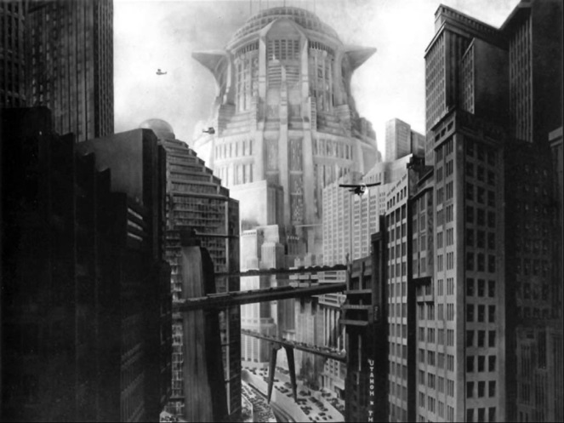

Slide 6
Reflective Journal
The Giver has enabled me to look at my surroundings more in depth. Appreciate little things that I usually take for granted such as, colour, imagination, individuality, being accepted into society and the ability to feel.
I appreciate my life more and the society I was born into. I have freedom and options, my life isn't planned out for me I can choose what I want to do. I feel safe and I know it’s okay to make mistakes so I can learn from them and not get ‘released.’ I stopped thinking about the negative side of things and focused more on the positive, when I feel optimistic it enables me to do more.
Every day I look around and smile when I see the different faces around me, appreciate the individuality of my friends.
I also worry if it will change, if it will plunge into a dystopia. The world seems nice now but will it last? Pollution and poverty is overtaking the world. I am careful with my actions, picking up rubbish, donating money to stop the world from turning into a dystopia. It may not be a perfect world, everyone’s interpretation of perfect differs but it could be worse. The Giver challenged me by making me more aware of surroundings and thinking over my life. It challenged me in a positive way.

Slide 7
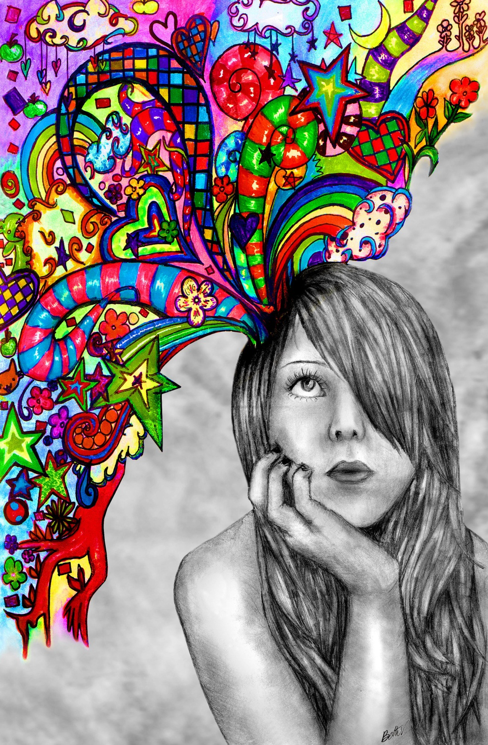
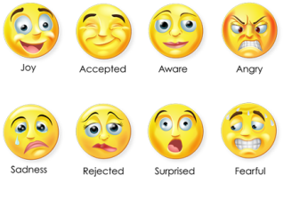

Slide 8
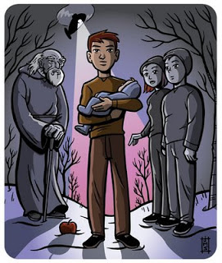
Did Jonas do the right thing?
Did Jonas to the right thing by leaving the community?
I think he did the right thing because he made his own choice. He broke lose from the chains holding him back. He told the authority, “You don’t control me, I'm not your robot.”
Jonas running away is a sign of independence and bravery. His first time away from his family unit. Taking Gabe with him showed he is responsible and has feelings. He defied the system and made his own choice. That alone takes a lot of courage, he was aware of the consequences but that didn’t change his mind. He was tender with Gabe and treated him like his own brother. It shows that you can’t suppress emotions, our feelings are what we are. They build our character.

