Slide 1
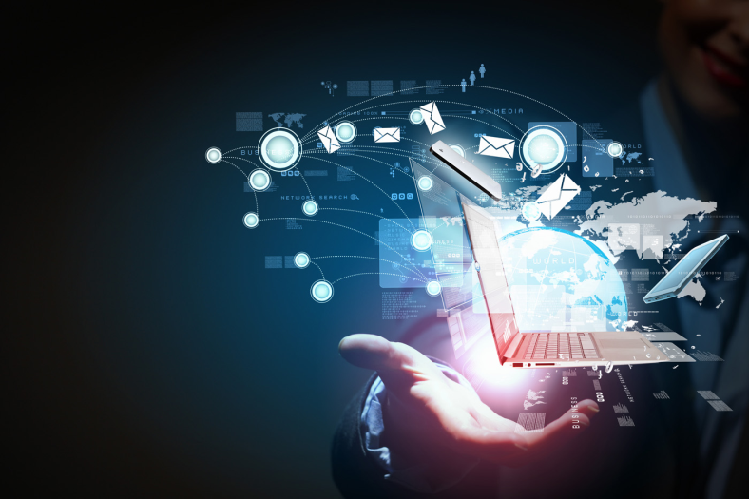
Our Changing Worlds
Technology & Future Communities
By: Jena Konesan and Emaan Alamgir

Slide 2
Technology has dramatically enhanced our lives over the years…
But the question we must ask ourselves is: is it all good?

Slide 3
Pros | Cons
Faster access to information , more resources | Online fraud-As for example, impostors may steal your credit card information and use them for their own monetary gain.
Increases communication i.e. fb , twitter , instagram | Dependency on technology -People are becoming mechanical as they are getting more and dependent on gadgets
Technology can be used to advance in the medical field I.e. find a cure for cancer , diabetes , new surgical methods etc… | Integrating new technology: It is often difficult to take a business related decision about whether to buy the latest technology or wait for some new invention
Speed up work- increase work efficiency and is not time consuming like household appliances etc… | Technology related diseases: Human beings are becoming addicted to the new technologies and gadgets, especially, internet and computers.
Used as way to improve the quality of life , food , modify genes in animals etc… | Online cyber bullying

Slide 4
The Dangers
Can be used to sustain and increase power of an individual
Isolation – Technology is acting as a social barrier by hindering us to have proper conversations.
Governments / criminals can monitors and control every aspect of human life to the extent
The lethal innovation allows perpetrators to use modern information communications technologies, including smart phones, satellite imagery advanced weaponry

Slide 5
Technology and Our World
How people use the technology will solely be dependent if it helps or harms humanity and how people want to use technology in the changing world.
It is ultimately us humans who decide how to use that technology. Hopefully , people realise in the future our changing world that technological devices are not to be used as an instrument of abuse but rather as a means of curing disease and enhancing our lives.

Slide 6
Our Future
It is extremely obvious that our world has changed immensely since the time civilization began and it is doing even more so now with the technological revolution.
Everyday we are exposed to new and innovative technology that aims to make our lives more enjoyable and easier. We have phones, tablets, computers, music devices and countless other devices that basically command our existence.
But one must ask the question, ‘What does this mean for our future?’

Slide 7
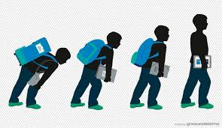
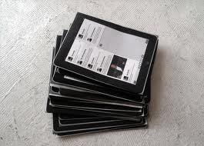
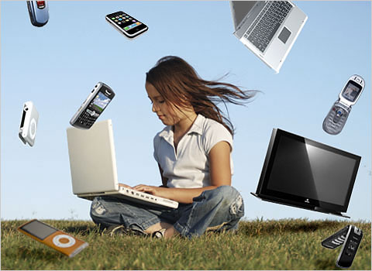
Education Online

Slide 8
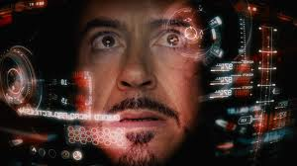
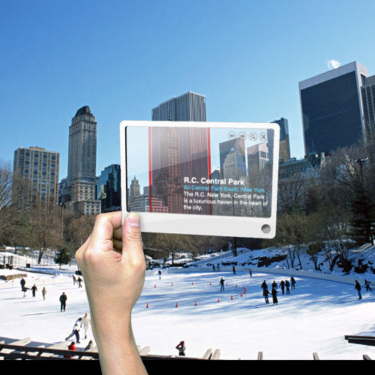
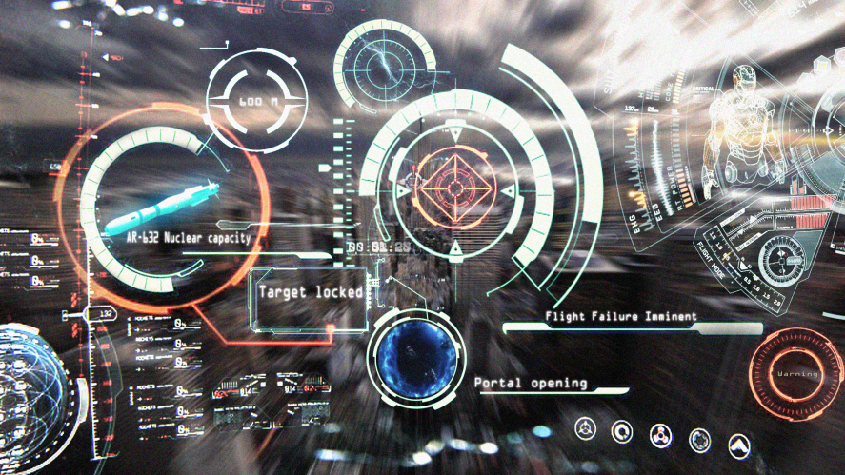
Augmented Reality

Slide 9
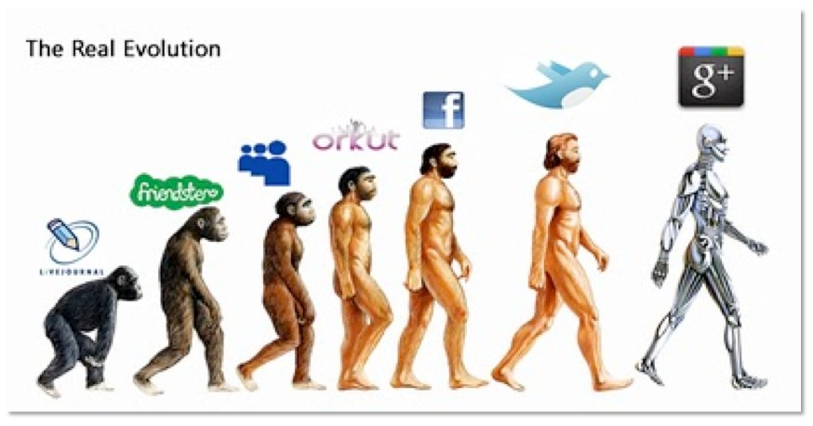
Breakdown of Social Interaction

Slide 10
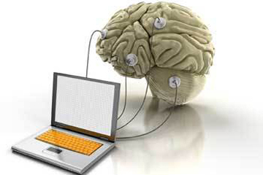
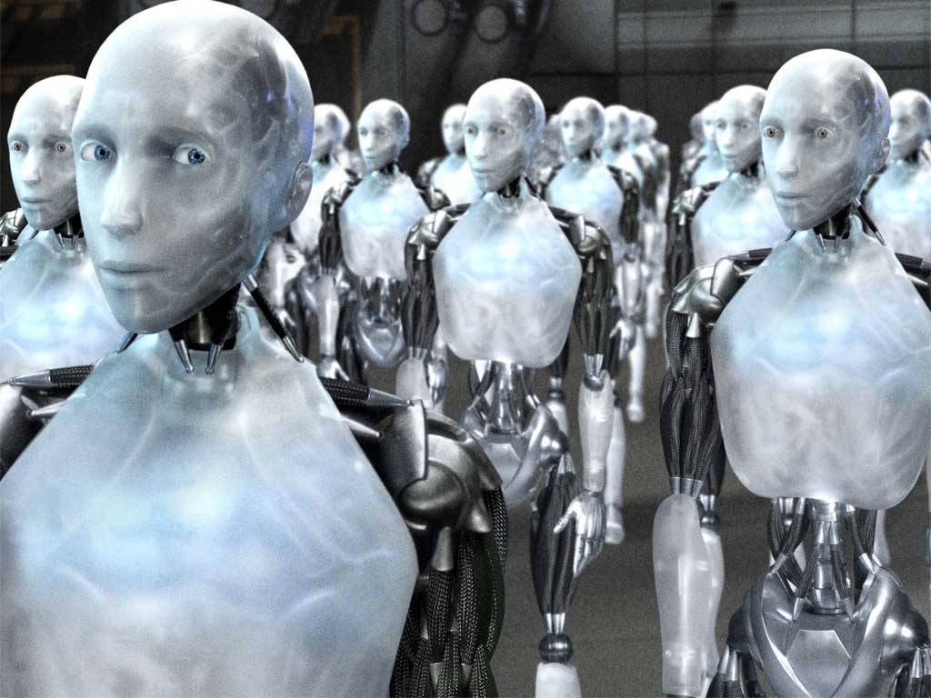
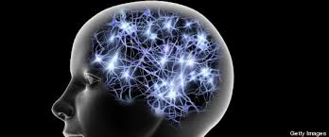
(Digital) Immortality

Slide 11
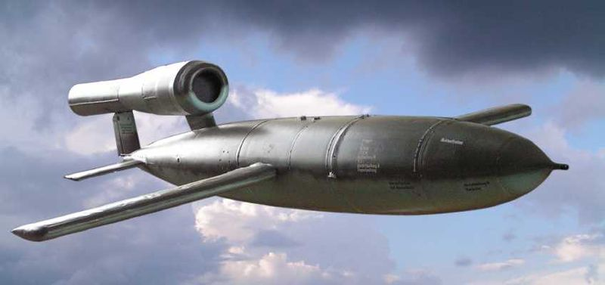
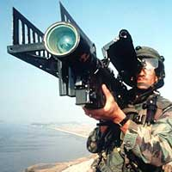
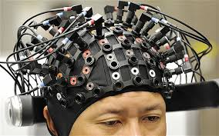
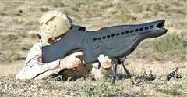
Destruction

Slide 12
http://www.youtube.com/watch?v=YRcIFwFZeU8

Slide 13
FIN.

Slide 14
Bibliography
Book- Rutgar Van Santen, 2030: Technology That Will Change the World, Oxford University Press, USA (September 16, 2010)
Website- Mindi Orth, http://smallbusiness.chron.com/technology-communicate-27322.html, (view 11/11/13)
Website- Ptrik J. Kiger, http://electronics.howstuffworks.com/future-tech/5-ways-society-will-be-affected-by-cognitive-technology.htm#page=5, (view 13/11/2013)

